Slide 1
A New Functional-Logic Compiler for Curry: Sprite
Andy Jost
Portland State University and Synopsys, Inc.
In collaboration with Sergio Antoy
Supported by NSF grant #1317249 | LOPSTR: Sept. 7, 2016

Slide 2
≈ Haskell with logic
Logic variables.
Unification.
Explicit non-determinism.
Functional patterns, i.e., functions may be applied in patterns.

Slide 3
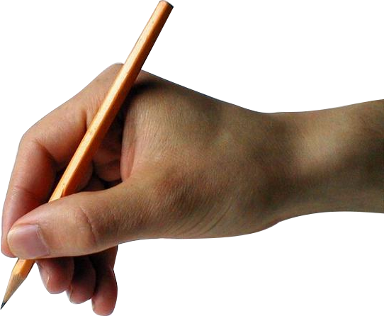
Sprite is a new Curry compiler.
Its goals are to demonstrate the Fair Scheme in practice, and produce better results with a simpler implementation.

Slide 4
The Fair Scheme
A sound, complete, optimal, and deterministic compilation scheme.
Transforms Limited-Overlapping Inductively Sequential (LOIS) systems into equivalent rewriting systems.
Can probably be extended to narrowing (not yet published).
Graph
Rewriting
System
Curry
LOIS
(Implemented in LLVM)

Slide 5
What does fair mean?
No part of a computation is neglected forever.
. . . which leads to completeness:
any result is eventually produced
(given enough resources).
Source: Getty images

Slide 6
Fair Scheme Topics
The Pull-Tab Transformation
Fair Evaluation
Consistent Evaluation

Slide 7
Fair Scheme Topics
The Pull-Tab Transformation
Fair Evaluation
Consistent Evaluation

Slide 8
In a LOIS system,
all non-determinism
is in the choice operator.
a ? b = a
a ? b = b

Slide 9
Pull-tabbing provides a structural representation of non-determinism.
easyto implement
correct
efficient
stepwise
parallelizable
local

Slide 10
f
u
v
?
The Pull-Tab transformation
a
b

Slide 11
?
f
f
The Pull-Tab transformation
u
v
a
b

Slide 12
f
u
v
?
?
a
b
f
f
The Pull-Tab transformation
u
v
a
b

Slide 13
Pull-tabbing duplicates choices. . .
1
2
?

Slide 14
Pull-tabbing duplicates choices. . .
1
2
. . . so each choice is labeled with an identifier.
?
_{i}

Slide 15
Fair Scheme Topics
The Pull-Tab Transformation
Fair Evaluation
Consistent Evaluation

Slide 16
Fair Scheme Topics
The Pull-Tab Transformation
Fair Evaluation
Consistent Evaluation

Slide 17
control block
Queue
?
a
b
Computations are arranged into a queue.
computation states

Slide 18
?
a
b
An active computation receives work.

Slide 19
?
a
b
After a timeout, Sprite forces a context switch.

Slide 20
?
a
b
After a timeout, Sprite forces a context switch.

Slide 21
?
a
b
After a timeout, Sprite forces a context switch.

Slide 22
?
a
b
After a timeout, Sprite forces a context switch.

Slide 23
?
a
b
After a timeout, Sprite forces a context switch.

Slide 24
?
a
b
After a timeout, Sprite forces a context switch.

Slide 25
?
a
b
When a choice reaches the root . . .

Slide 26
?
a
b
When a choice reaches the root . . .
. . . the computation forks.

Slide 27
a
b
When a choice reaches the root . . .
. . . the computation forks.

Slide 28
a
b
When a choice reaches the root . . .
. . . the computation forks.

Slide 29
L
R
a
b
When a choice reaches the root . . .
. . . the computation forks.

Slide 30
a
b
When a value reaches the root . . .

Slide 31
(print )
a
b
When a value reaches the root . . .
. . . it is yielded.

Slide 32
Fair Scheme Topics
The Pull-Tab Transformation
Fair Evaluation
Consistent Evaluation

Slide 33
Fair Scheme Topics
The Pull-Tab Transformation
Fair Evaluation
Consistent Evaluation

Slide 34
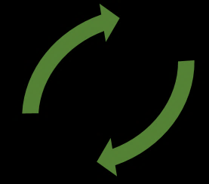
Choice decisions must be consistent.
L
R
?_{i}
?_{i}
(a duplicate of ?_{i} )

Slide 35
Fingerprints hold consistency information.
$$Id→\left\{L,R\right\}$$

Slide 36
$$\{ \}$$
i
$$↦L$$
$$. . .$$
$$\{ \}$$
i
$$↦L$$
$$. . .$$
?_{i}
a
a
b
Discard the rightward alternative because it is inconsistent.

Slide 37
Implementation
“How can Sprite hope to be both simple and fast?”

Slide 38
A high-quality compiler infrastructure
with financial support from Apple.
Competitive on quality-of-results.
Co-dominant (w/ GCC) for C/C++.
An optional backend for GHC.

Slide 39
With LLVM, we can simplify the implementation without giving up speed.

Slide 40
Plus, no coupling to another language.

Slide 41
Let’s use LLVM!

Slide 42
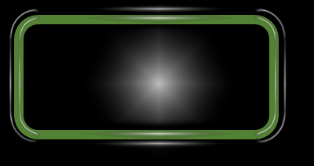
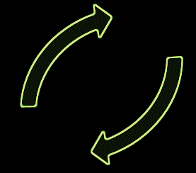
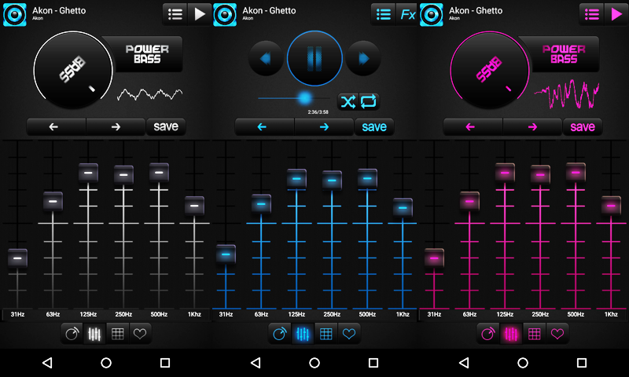
Let’s use LLVM!
LLVM IR
integer
floating
struct
pointer
array
vector
function
label
branch
instruction
call
load
store
static
inline
extern
optimizer
backends
machine code
x86
PowerPC
01101001010100100001001101000110
ARM
GPU

Slide 43
frontends
machine code
01101001010100100001001101000110
LLVM IR

Slide 44
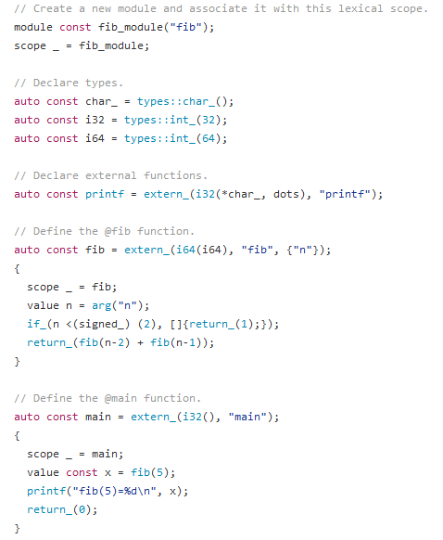
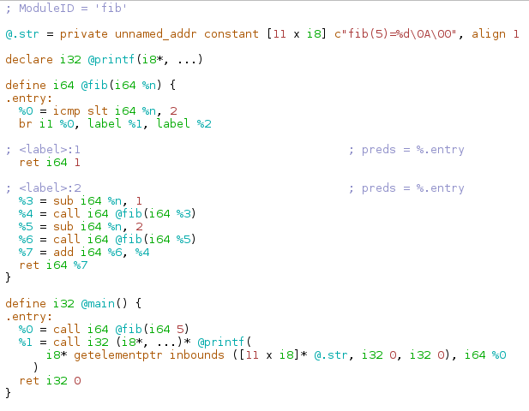
Fibonacci Example
Sprite LLVM DSL code
LLVM IR output

Slide 45
The Sprite frontend
1. Convert to FlatCurry.
Makes the pattern-matching strategy explicit.
Makes the representation uniform.
2. Compile to LLVM IR.
Defines the link from FlatCurry to LLVM IR.
Needs a data model and evaluation strategy.

Slide 46
Implementation Topics
Case Evaluation
Fingerprint Representation

Slide 47
Implementation Topics
Case Evaluation
Fingerprint Representation

Slide 48
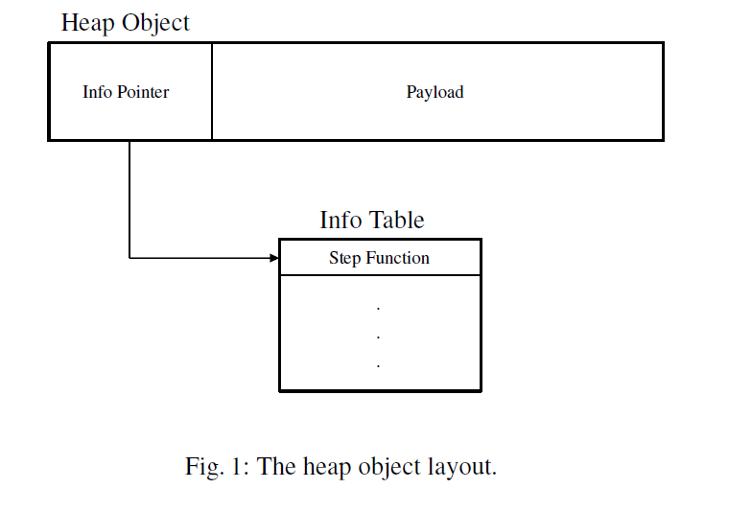

Slide 49
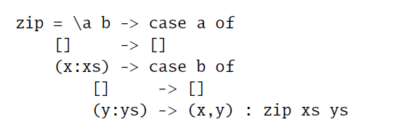
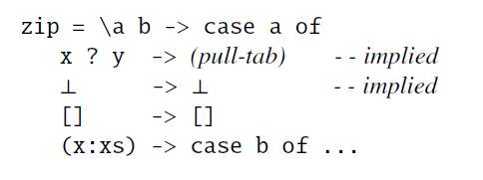
Source code
FlatCurry
Implementation

Slide 50
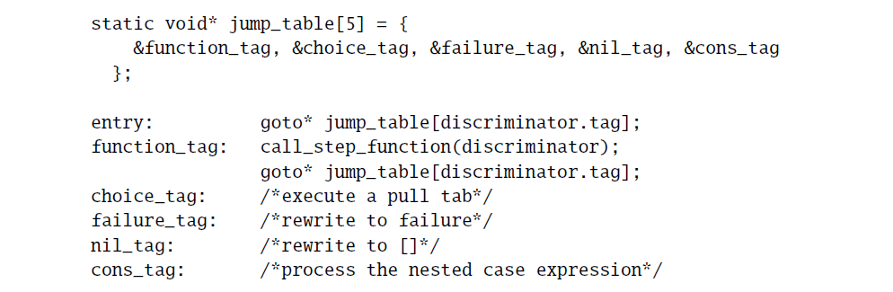

Slide 51
Implementation Topics
Case Evaluation
Fingerprint Representation

Slide 52
Implementation Topics
Case Evaluation
Fingerprint Representation

Slide 53
Fingerprint Considerations
unbounded
The number of choices is unbounded (in principle).
The entire fingerprint is copied often.
Insertions and lookups occur frequently.
Also, the fingerprint should be efficient for large and small programs.

Slide 54
Solution: Uniform-depth trees
...
...
...
N <= 16
N <= 8
…
…
N <= 4
0..3
4..7
8..11
12..16
0..3
4..7
0..3
4..7
Optimizations
Complexity
Store all leafs in a static table (256 bytes).
Expand trees lazily.
COPY-ON-WRITE semantic for branches.
Copy $O(1)$
Insert $O(\lg{N})$
Lookup $O(\lg{N})$

Slide 55
MCC – Implements Curry as C.
Uses backtracking.
Very fast, but not complete.
PAKCS – Translates Curry to Prolog.
Uses backtracking.
Relies on built-in search for non-determinism.
No control over the search strategy.
Must simulate functional features.
KiCS2 – Translates Curry to Haskell.
Uses pull-tabbing.
Must simulate logic features.

Slide 56
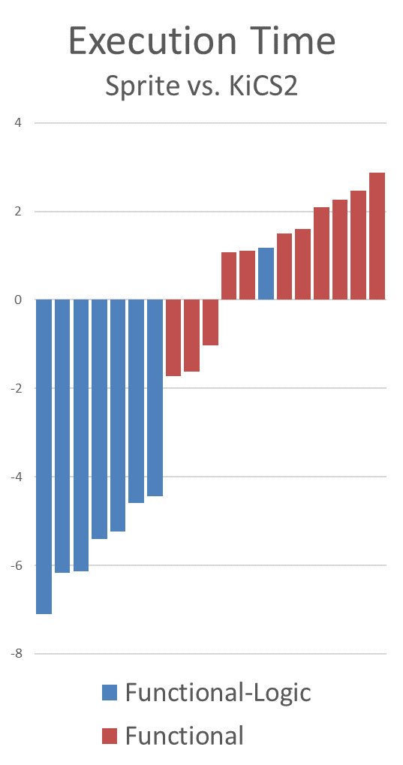
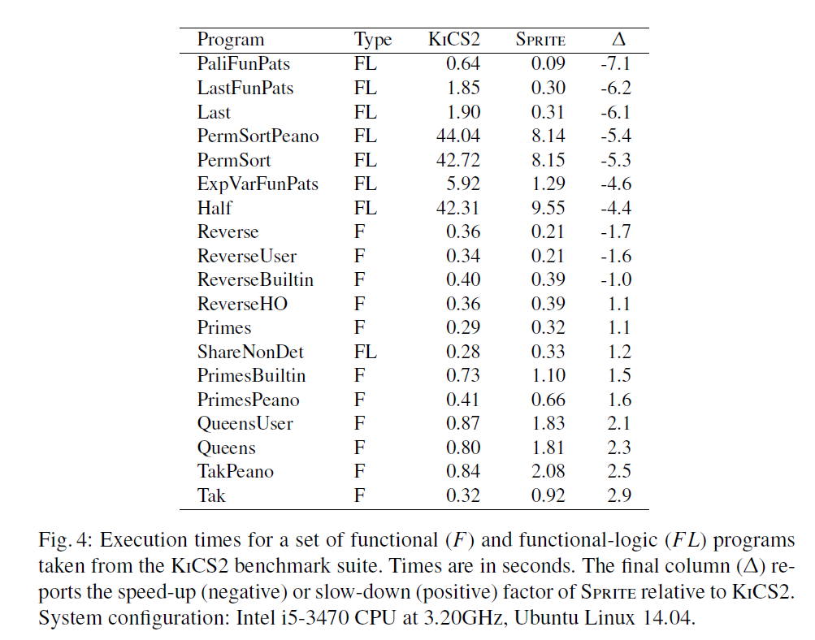
Benchmarks
Factor of Change
(less means Sprite is faster)

Slide 57
Future work
Insert a pre-LLVM optimization pass to leverage GHC:
LOIS → GHC Core → GHC Core → LOIS
Idea:
Declare choices as external functions that GHC cannot optimize.
Extract optimized GHC core.

Slide 58
Summary
Sprite is a new Curry compiler.
Sprite implements the Fair Scheme.
Sprite uses LLVM for speed, simplicity.

