Slide 1
One Page Presentations

Slide 2
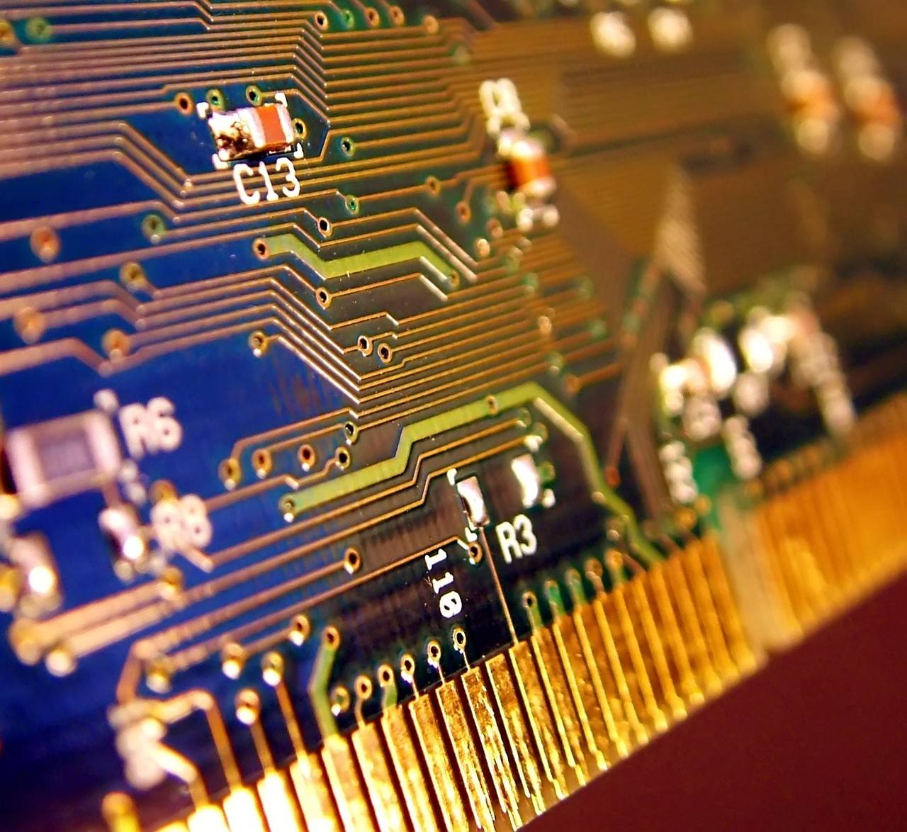
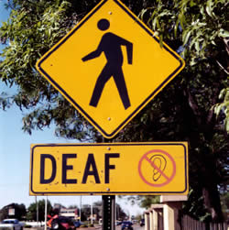
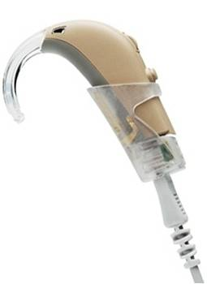
Technology enables the deaf to communicate
Hearing aids have allowed the deaf to hear.
Children are able to learn ASL at a early age.
The internet enables people to communicate.
Deaf people can now interact with the world in a way they have never been able to do.
Anthony

Slide 4
David Moe

Slide 5
Jacqueline

Slide 7
Kylee

Slide 8
Lindsey

Slide 9
Nikki

Slide 10
Omar

Slide 11
Eileen

Slide 12
Dinela

Slide 13
Sally

Slide 14
Scott

Slide 16
Victor

Slide 17
Aaron

Slide 18
Brian B

Slide 19
Bryan A.

Slide 21
Ryan J.

Slide 22
Alex

Slide 24
Jacob

Slide 25
Minh

Slide 26
Rob H

Slide 27
Alex

Slide 28
Andrei

Slide 29
Troy A.

